Slide 1

Welcome to Year 2

Slide 2

Meet the Staff
Teachers :-
Mr Eardley & Mrs Kawagoe
Teaching Support Staff:-
Mrs Grant, Mrs Kenyon, Mrs Mitton,
Miss Hales & Mrs Wigfall

Slide 3
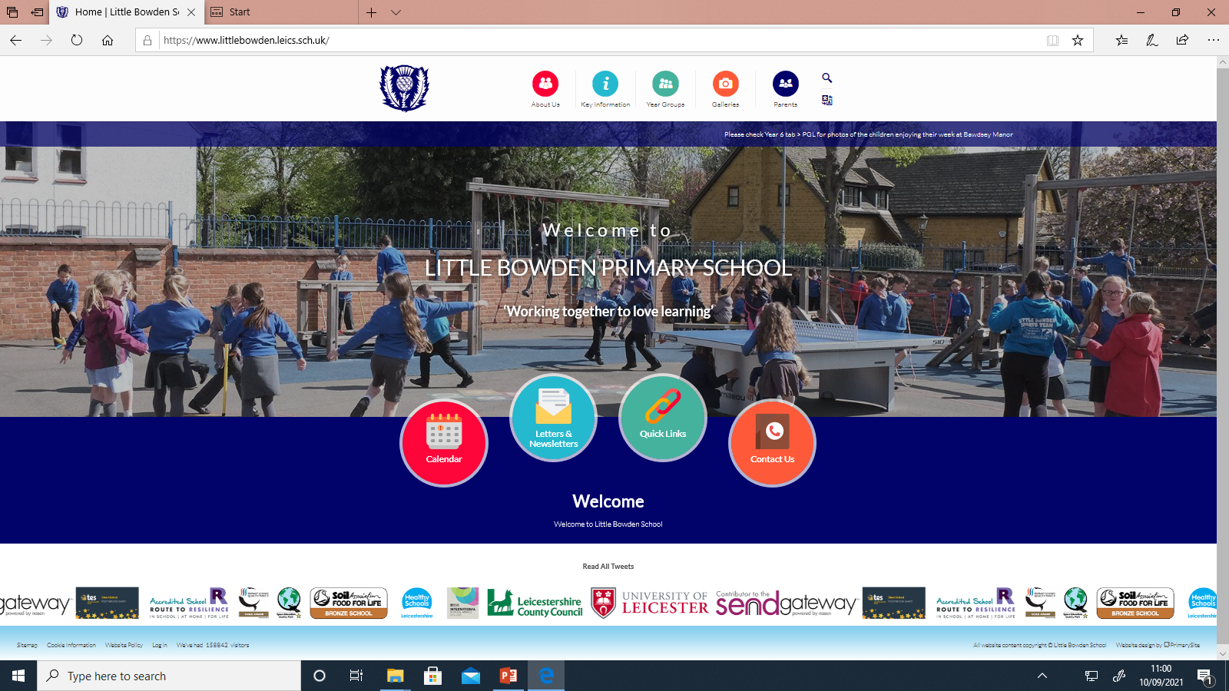

Slide 4
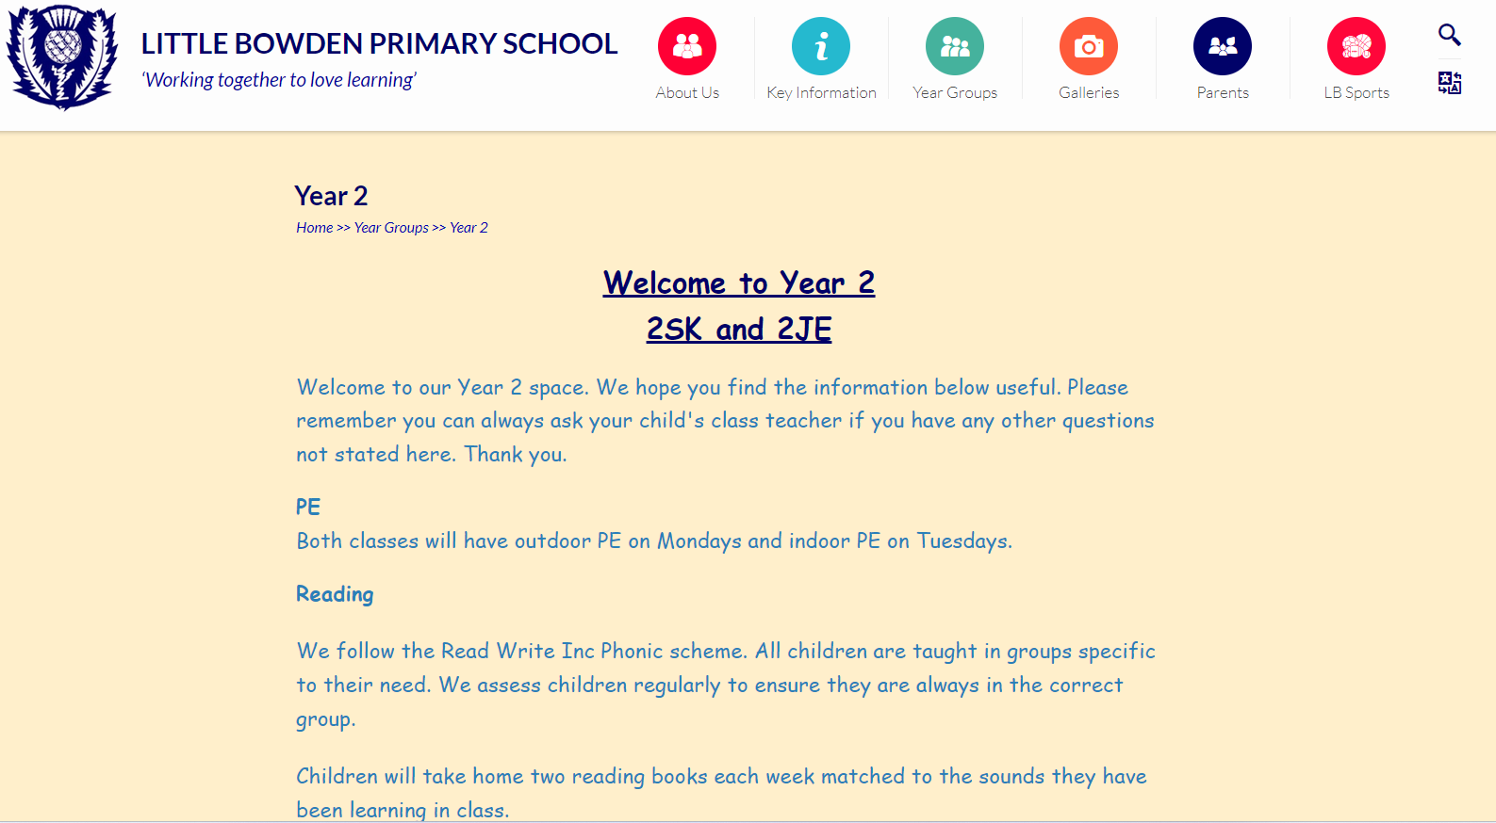
Our Year 2 page will provide you with information on :​
​
what we are focussing on learning ​
key information for the year group​
expectations we are working towards throughout the year.​

Slide 5
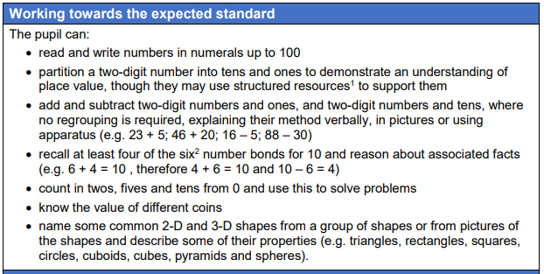
Maths

Slide 6
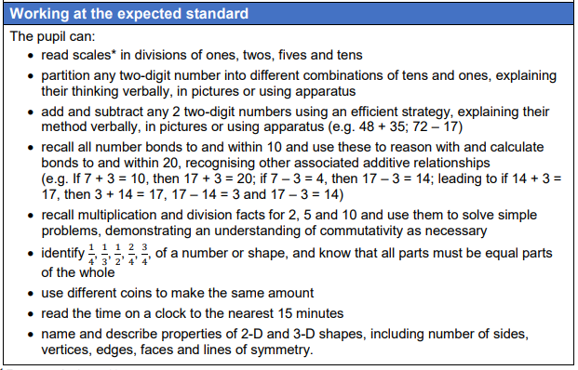

Slide 7
Partition of 2 digit numbers
17
25
10
7
20
5

Slide 8
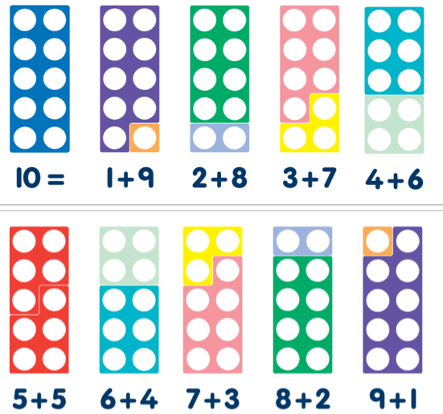
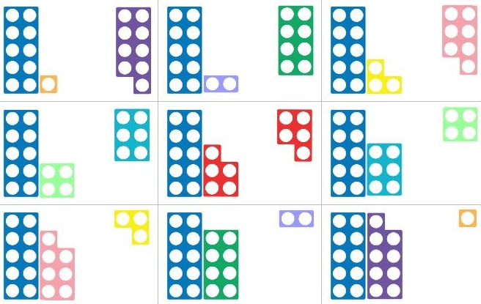
Number bonds
What numbers we can join together to make up to ten and using the reasoning to count bonds up to 20

Slide 9
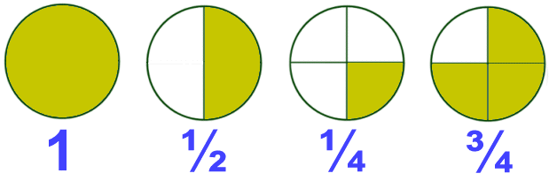
Fractions of shapes
Words we use include “equal” “parts” and “whole”
Using real life instances, such as pizza, cakes etc to demonstrate the principles of equal parts

Slide 10

Multiplication and division. Arrays.

Slide 11
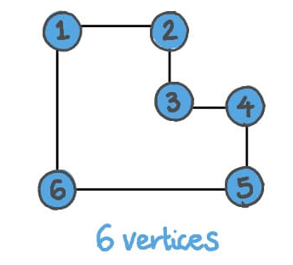
2D & 3D shapes
Words we use include
vertices (corners)
sides
edges

Slide 12
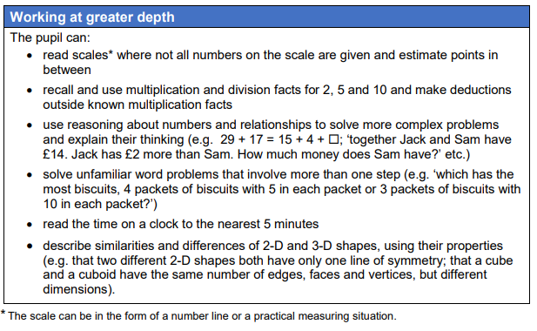

Slide 13
Reading
Children will start off developing their skills to segment and blend words using their phonics to help them read.
Also, they will need to develop their sight vocabulary on the high frequency (common exception words)
We follow the Read Write Inc Phonic scheme. All children are taught in groups specific to their need. We assess children regularly to ensure they are always in the correct group.
Later on …
They will work on fluency and develop reading comprehension skills, including retrieval and inference.

Slide 14


Slide 15
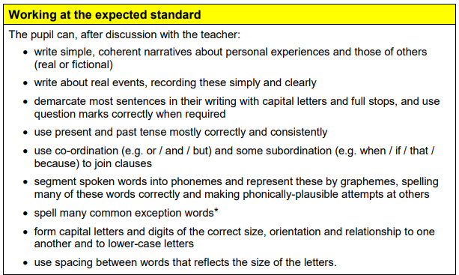
English

Slide 16
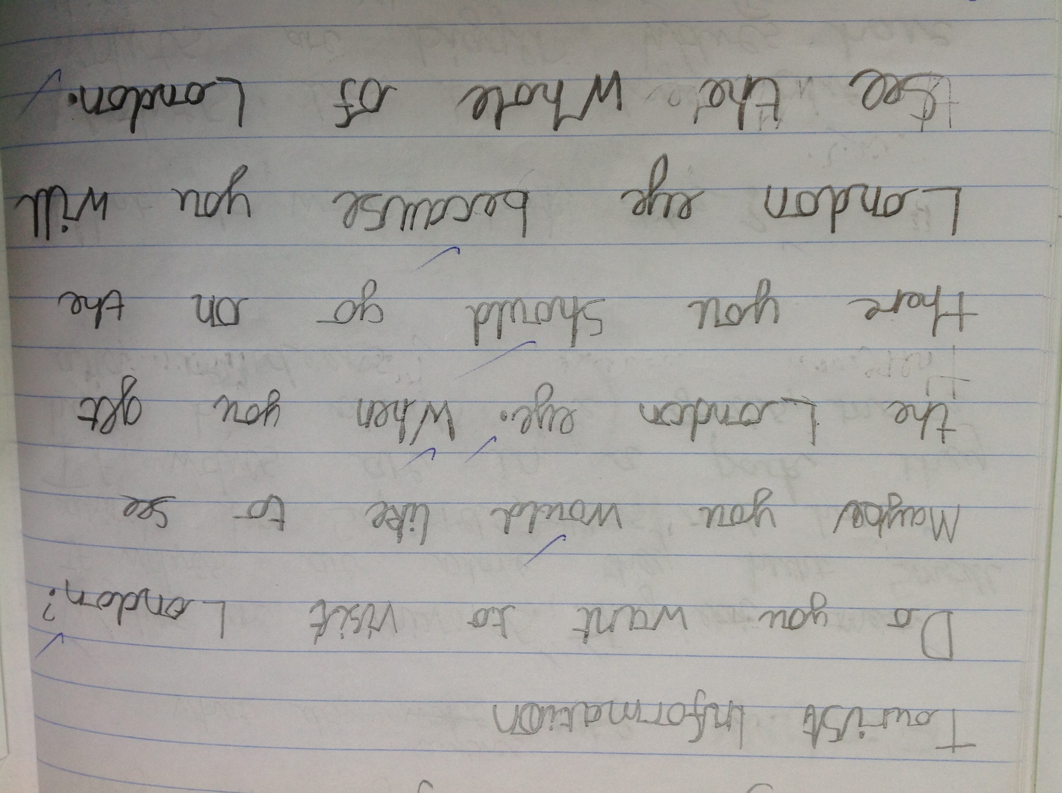

Slide 17
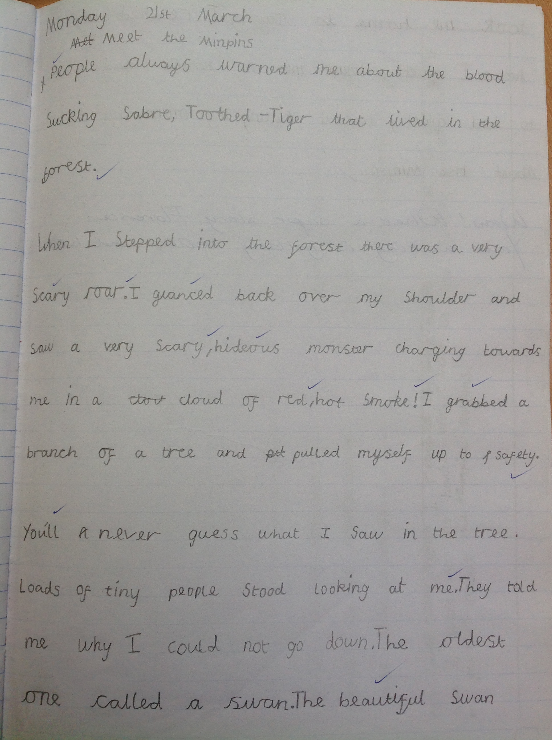
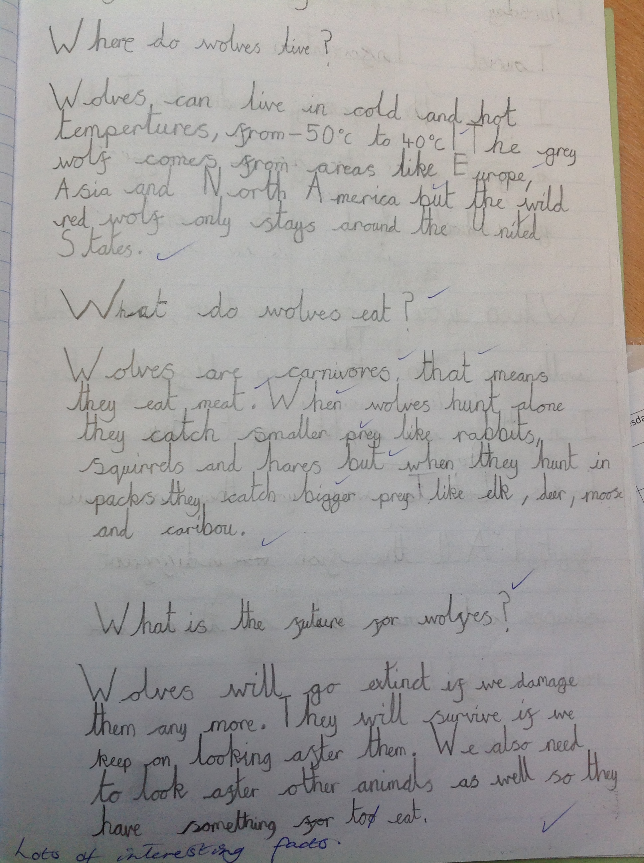

Slide 18
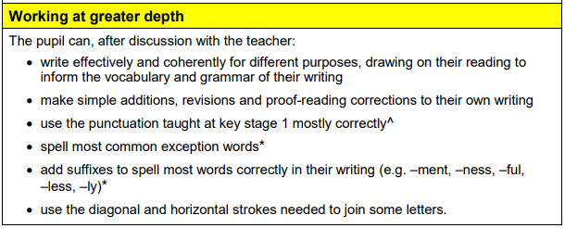

Slide 19
