Slide 1
Welcome to Year 3!
Notes:
1

Slide 2
Meet the team
Mr Bhojani
Mrs Loomes
Miss Smith
Mrs Fairhurst
Notes:
James
2

Slide 3
Important information
PE days – Tuesdays and Fridays
Name clothing – coats, hats, jumpers, cardigans, shoes
Water bottles - named
Snacks – healthy, no nuts
Homework
Website
Notes:
Sarah
3

Slide 4
Year timetable
Our week:
Maths everyday
English everyday
Spelling
Grammar
Writing
Handwriting
Reading
PE x2
RE/Music/PSHE/History/Geography/Science/Singing/Computing
20XX
presentation title
4

Slide 5
Year 3
English
Expectations

Slide 6
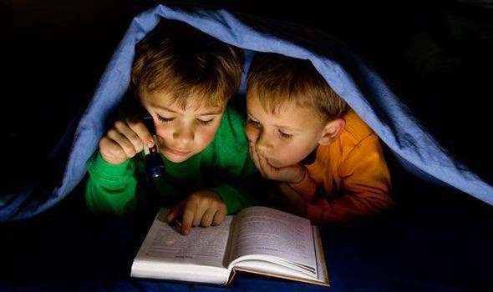
Reading
At home:
10 minutes a day
Make it fun
Share books
In School:
Fluency and expression
Comprehension
Stamina
Enjoyment
Vocabulary

Slide 7
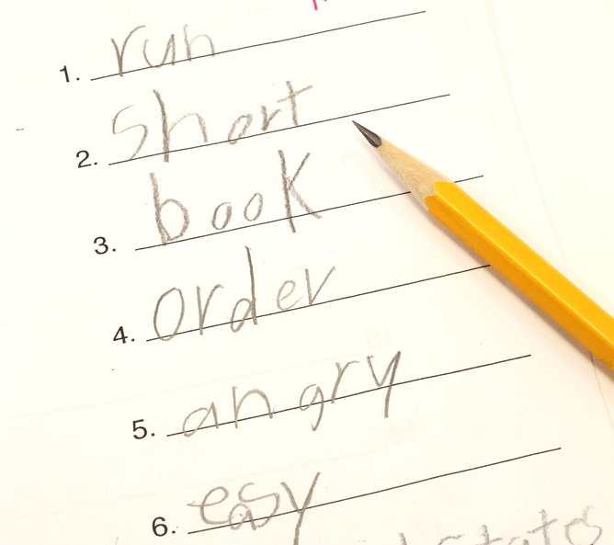
At home:
Look, cover, say, write, check
Use strategies for tricky words
Practise using a dictionary
Spelling homework – 3 week rota: spelling pattern investigation, orange words, handwriting for consolidation
Spelling
In School:
Root words
Prefixes
Suffixes
Patterns
Tricky words
Dictionaries
Thesaurus

Slide 8
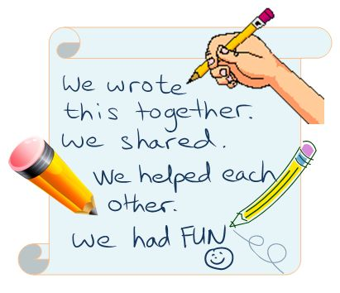
Writing
In School:
Each sentence makes sense.
Capital letters and full stops are in place.
Also using ! ‘ ’ , ‘ ?
Make sentences more interesting by adding:
- adjectives
- adverbs
- exciting verbs
- sentence starters
- conjunctions
Simple paragraphs
TOP TIP
The more you talk at home, the better your child’s vocabulary will be.
Use challenging vocabulary and explain what it means.

Slide 9
Year 3 maths expectations

Slide 10
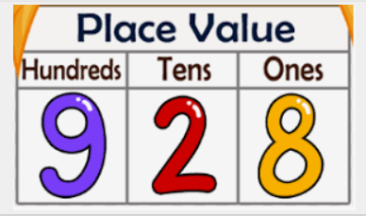
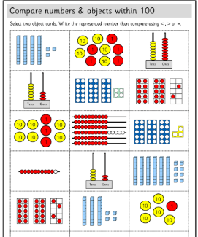
Place value
In School:
Understanding the value of numbers
Where do those numbers sit in relation to other numbers?
Knowing what the number is made of to support mental calculations and problem solving
At home:
Counting in different steps (multiples of) forwards and backwards
Playing board games (change the rules/ invent your own!)
Measure things!
Real life maths

Slide 11
Calculations
Add and subtract numbers mentally, including:
a three-digit number and 1s
a three-digit number and 10s
a three-digit number and 100s
Recall and use multiplication and division facts for the 3, 4 and 8 multiplication tables – Heavy emphasis on times tables.
Times Table Rock stars in school and at home

Slide 12
Problem solving
Problem solving or Reasoning is a key expectation in year 3.
It allows children to use the knowldege they have learnt in context.
This allows knowledge to be embedded and applied.
This can be applied with real life activities at home such as baking or with money.
The more you familiarise the children with key vocabulary, the more confident they’ll feel when applying it in class.

Slide 13
Talk4Maths
In KS2 we use “STEM” sentences
It is important for the children to clearly explain their reasoning and thought process
It helps them to hear different strategies, share ideas, try new approaches, become better communicators
Guess my number
Try to be positive!
Don’t say “I hated maths at school”.

Slide 14
Homework

Slide 15
New approach to spelling homework
3 weekly rota
Emphasis on investigation rather than rote learning
Linked to the RWI spelling programme and the orange words.
Retrieval built in.

Slide 16
Week 1
Spelling investigation and sentence writing.
Children given a homework sheet to complete.
They are asked to find more examples of the spelling pattern being taught in the RWI spelling unit.
They write 3 sentences (or more) including the words they have found.
Children hand in their homework sheets and the words are shared. The best examples are displayed on the word wall along with examples from the RWI spelling unit.

Slide 17
Week 2
A set of orange words are studied in class.
A homework sheet is sent home.
The children choose a strategy to learn each word.
They practise with Look, Cover, Say , Write and Check.
They write a sentence for each word.
The homework sheet is handed in.
An orange word spelling test takes place in school.
Orange words are displayed on the orange word wall.

Slide 18
Week 2 continued
Speed spell is used to check the orange words. When most children can spell a word correctly it can be removed from the orange word wall.

Slide 19
Week 2 continued

Slide 20
Week 3
Word patterns or orange words previously taught are revisited.
A handwriting sheet including the word is sent home.
The handwriting sheet is handed in.
In class the words are tested through a short dictation.

Slide 21
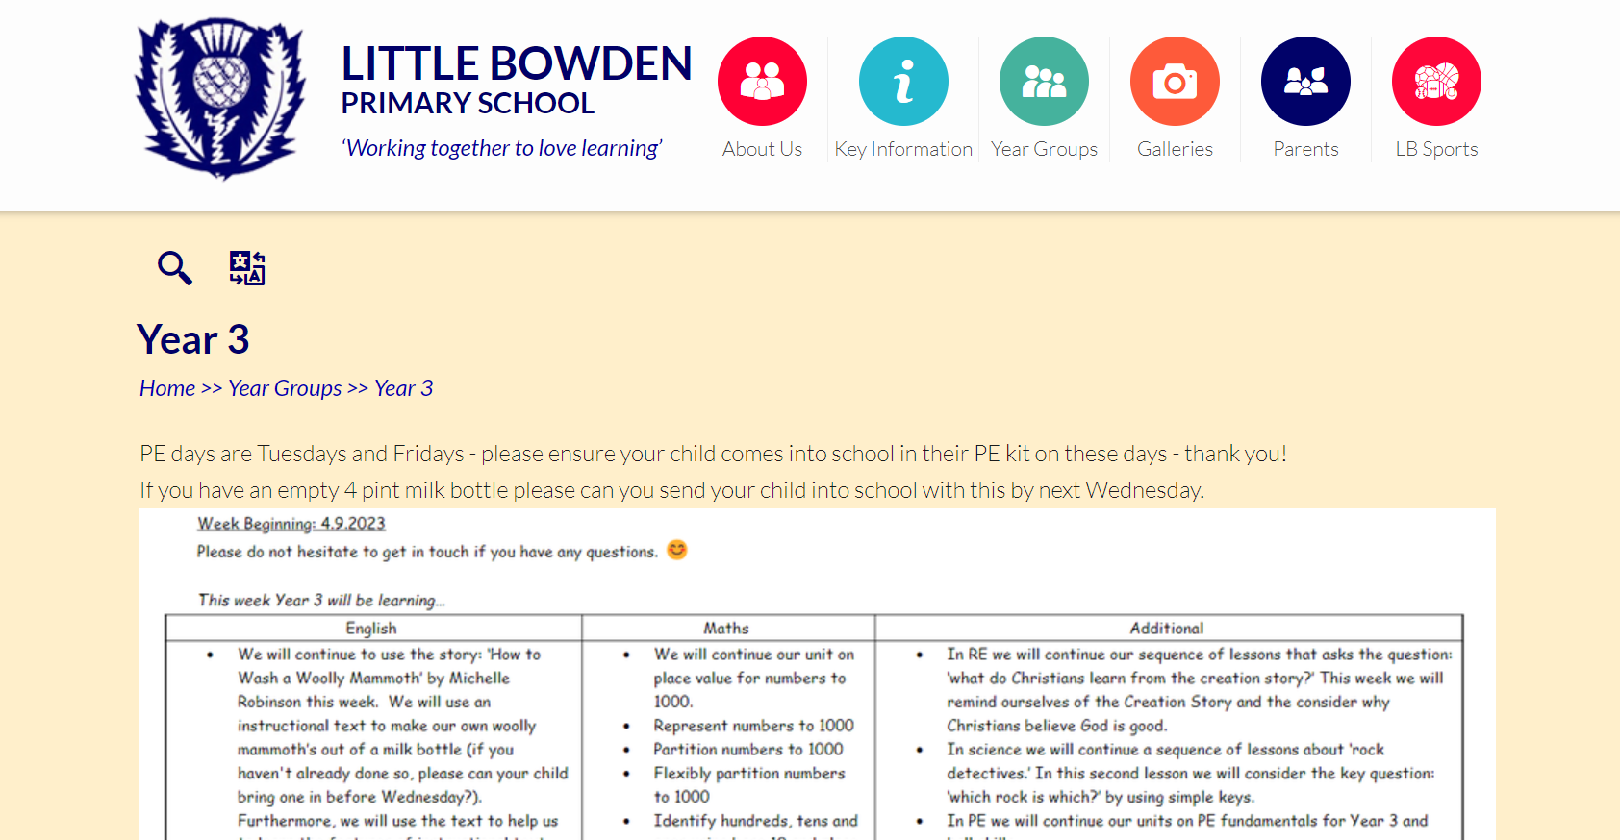

Slide 22
Any questions?
Notes:
22

Slide 23
Thank you
Notes:
23

