Slide 1
Open Classroom
Presentation
13.09.23

Slide 2
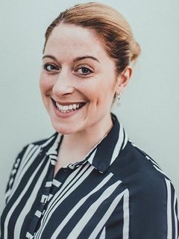
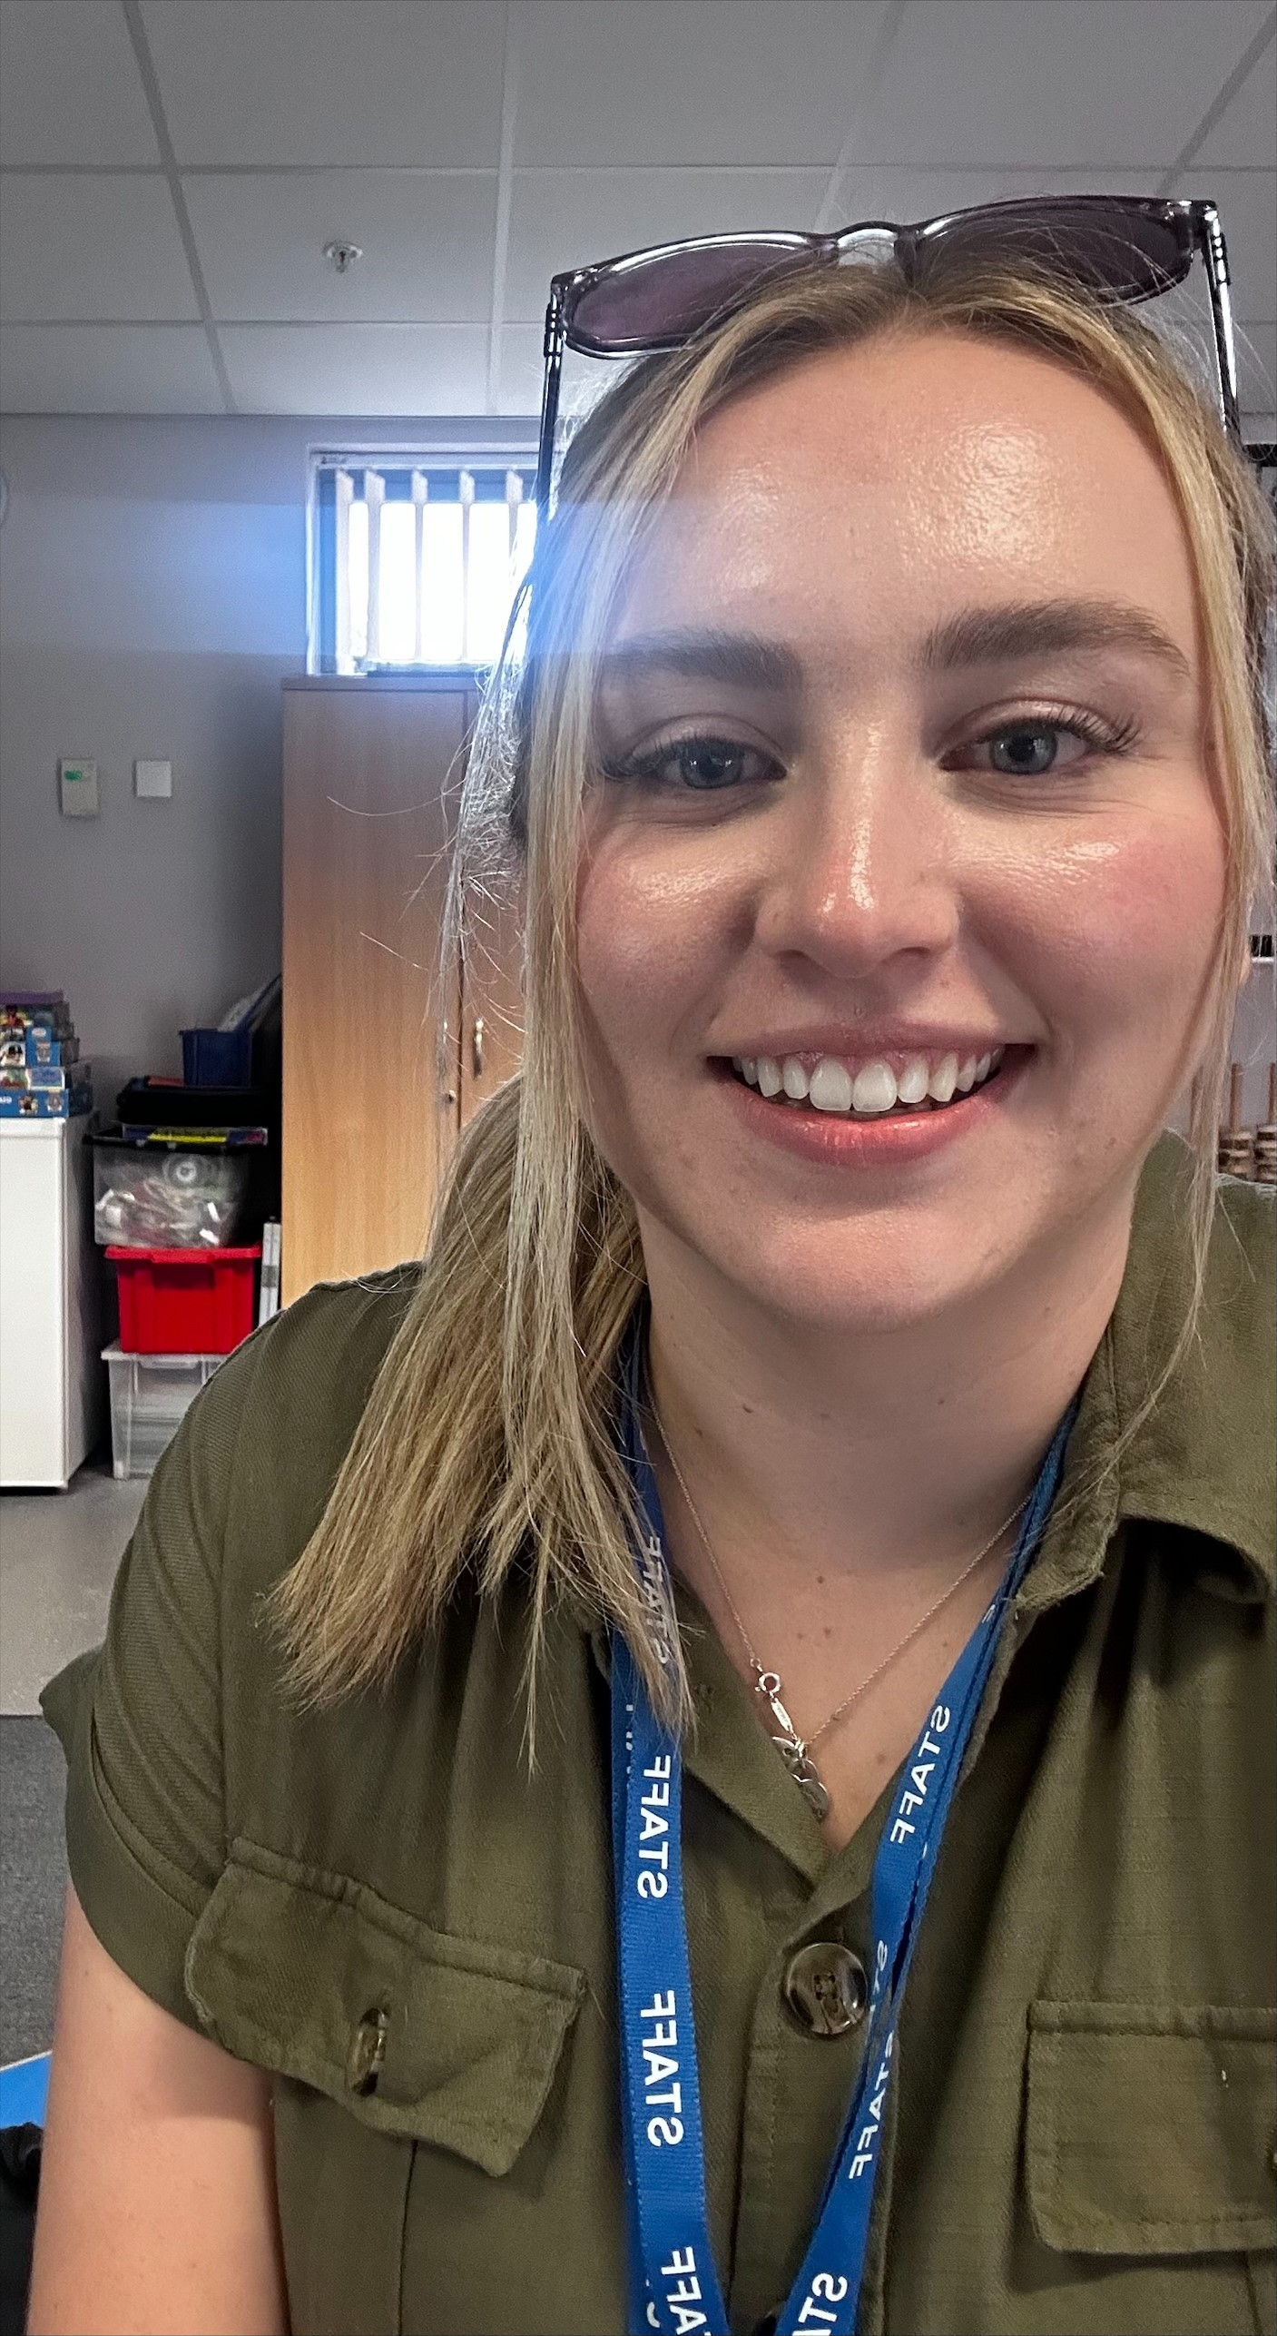
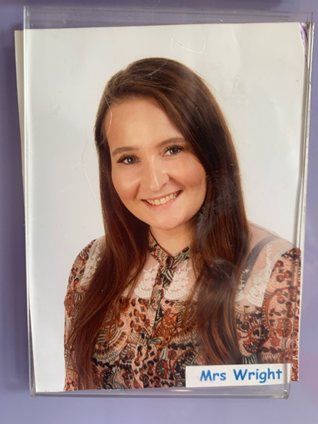
Meet the Team

Slide 3
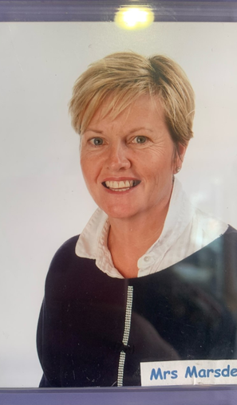

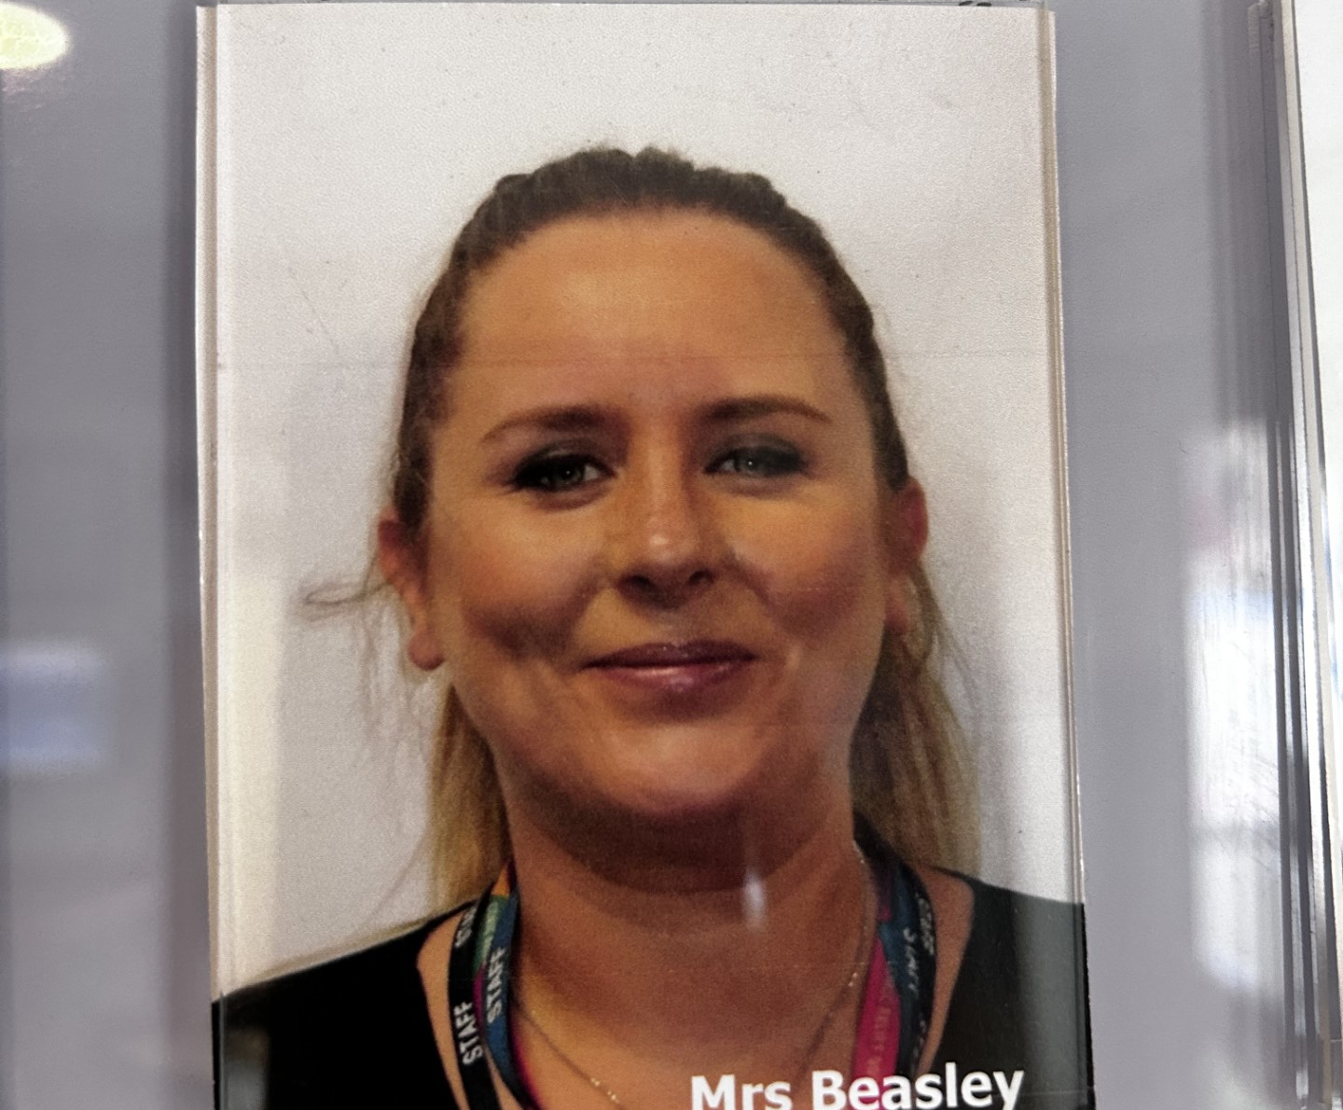
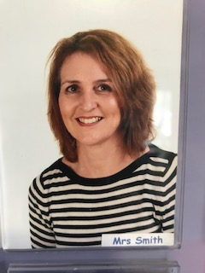

Slide 4
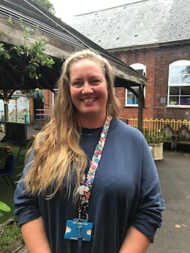
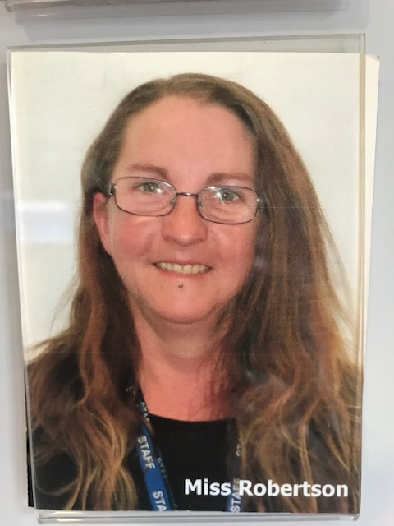
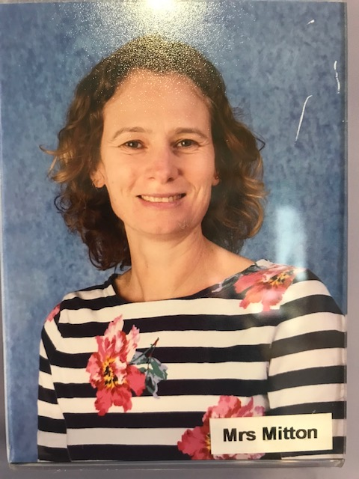
Miss Tobin and Miss Robertson 1:1 SEND TAs and Mrs Mitton our mid-day supervisor.

Slide 5
Our Weekly Timetable
Monday | Tuesday | Wednesday | Thursday | Friday
RWI Phonics Indoor/Outdoor CP | RWI Phonics Indoor/Outdoor CP | RWI Phonics Indoor/Outdoor CP | RWI Phonics Indoor/Outdoor CP | RWI Phonics Indoor/Outdoor CP
Break (10.30-10.50) | Break | Break | Break | Break
Maths NCETM session 1 Indoor/Outdoor CP | Maths NCETM session 2 Indoor/Outdoor CP | Maths NCETM session 3 Indoor/Outdoor CP | Maths NCETM session 4 Indoor/Outdoor CP | Maths SSM Indoor/Outdoor CP
Lunch 11.40 | Lunch | Lunch | Lunch | Lunch
UTW/EAD Indoor/Outdoor CP | UTW/EAD Indoor/Outdoor CP | P.D | PPA Indoor/Outdoor CP P.D. | UTW/EAD Indoor/Outdoor CP
Readers | Mandarin (1.30) | Readers | Readers | Readers
Break | Break | Break | Break | Break
Story time Home | Story time Home | Story time Home Staff Meeting | Story time Home | Story time Home

Slide 6
Reading Expectation
Share as many books as possible with your child (this can also be magazines and comics)
Explore Fiction and Non-Fiction books based on your child’s interest – Joining and visiting your local library is a great place to start!
When you hear your child read (tell a story aloud using the pictures) please write us a short comment in the yellow reading record. This way we know how they’ve got on and if they need their book changing etc.
Hear your child read at least once a week. Ideally every day. Research shows that the more you read with your child, the better their vocabulary and opportunities in later life.

Slide 7



Phonics Expectation
PowerPoint on website – Your Homework
Hand-outs (Phonics Handbook, Sound Mat, List of Red Words, Video links)
If anyone would like to speak to us one to one or in a small group please come and ask us.
Helpful buys; whiteboard pen and rubber to practise name writing and letter formation and the RWI Flashcards.

Slide 8
Maths Expectation

Slide 9
Literacy Expectation

Slide 10
End of Year Assessment
At the end of the year your child will be assessed against the Early Learning Goals. Your child will need to pass the prime areas of learning as well as Maths and Literacy (please see your hand-out) to make a good level of development.
A snapshot in time of where the children are – it is mainly to help year one teachers with transition and how to support them with their individual needs.

Slide 11
Homework Expectation
Reading – Hear your child read at home as much as possible
Phonics – practise sounds on a video with a letter formation sheet to support the learning. This doesn’t need to be handed back to the class teacher (only to support the learning at home).
Practise the sound flash cards with your child (approx £5 Amazon)
Practise reading and spelling the red words
Practise writing short lists and simple sentences - using your child’s sound mat (in hand-out)
Maths Homework – (see hand-out)
Please watch the Phonics presentation PowerPoint

Slide 12
Parent/Carer Pack (one pack per child)
EYFS Early Learning Goal Guide
Activities to try at home (in each of the ELG areas)
Help your child with Maths
Help your child with Reading
Phonics Guidance (Set One Speed Sounds)
Handwriting Guide (Pencil Grip and Posture) – to follow in book bags
Red Word List
Doubled sided sound mat
Wow Moments Sheet (already sent home, request more when needed)
Name Card – to practise over - please buy a whiteboard pen
Please watch the Phonics PowerPoint Presentation on our school website

Slide 13
Questions and Answers
Thank you for Listening
Please feel free to come and ask your class teacher a question if you are unsure about anything.

